Slide 1
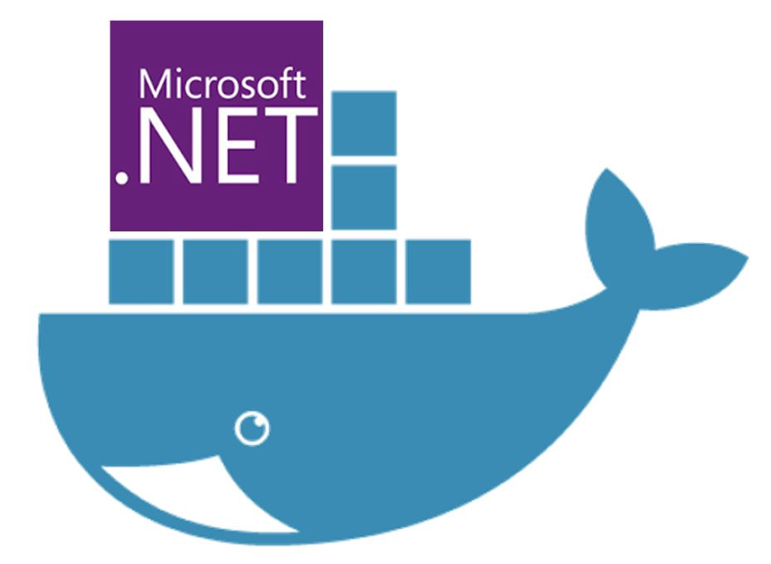
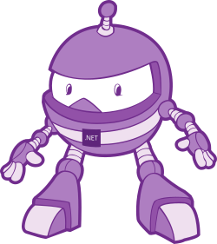
Dockerising .Net applications
Simplifying software delivery for .Net Devs (even if your boss says you can’t use Docker!)
Slides & code available on Github: https://bit.ly/2EO2lth (case sensitive!)

Slide 2

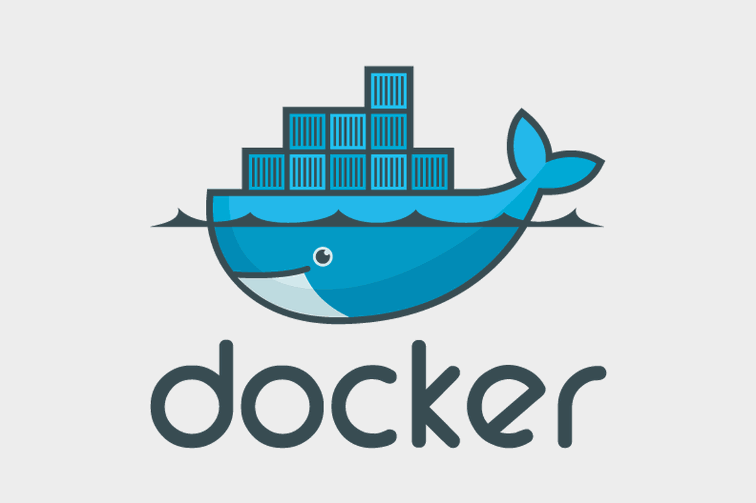
What is Docker?

Slide 3
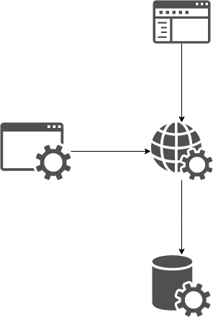
Context: Our Application Stack
Web
Front end
Web
API
Automated
Tests
Database

Slide 4
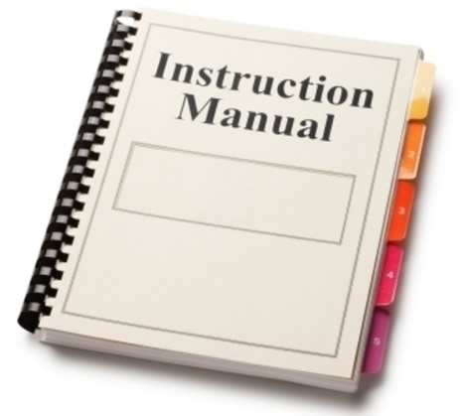

Setting up you Dev Environment
==

Slide 5
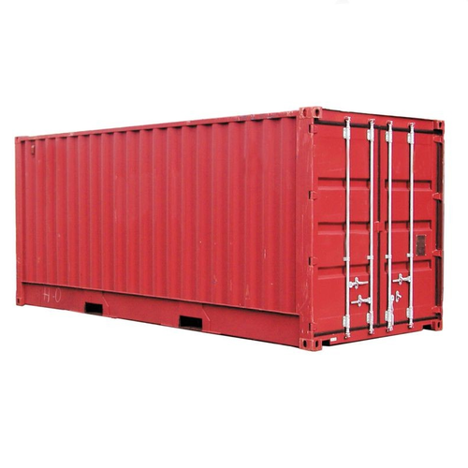

Same Stack, but running in containers

Slide 6
Demo 1

Slide 7
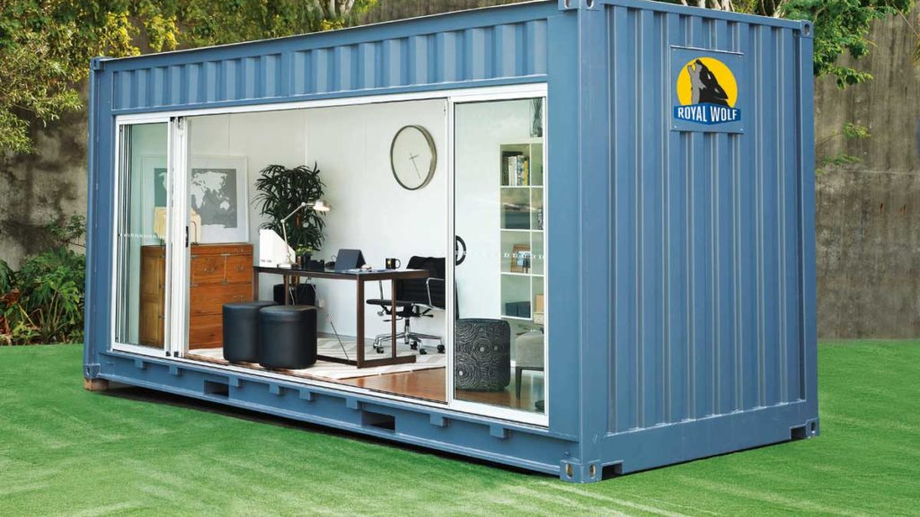
Use cases for Docker

Slide 8

QA / Testers

Slide 9

UI Devs

Slide 10

Devs

Slide 11
Context Switching
Application Y:
MVC
Web API
SQL Server
Application X:
React
Node.js
Mongo

Slide 12
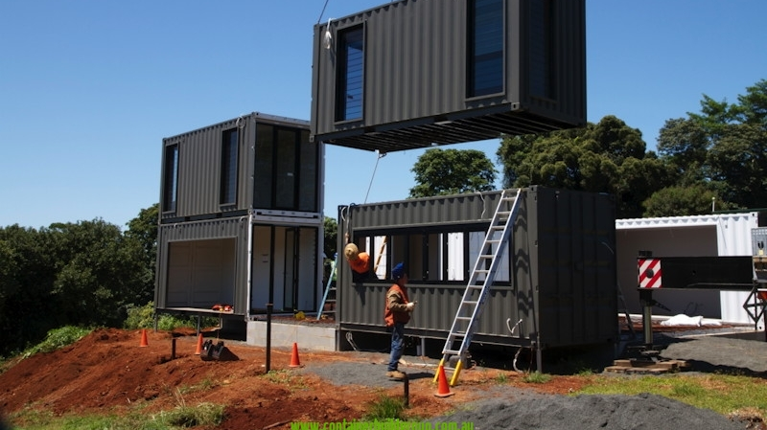
Building Containers
Containers are created from Images
Images describe your application, like blue-prints
Images are created using a Dockerfile
Notes:
Ok, so we now know what Docker is and have an idea of what it can do for us once we have our apps in Containers.
Now we need to know how to get our app inside a container?
You spin up a Container instance from an Image. (note the language I used there - spin up a Container Instance or Instances, from an image)
A Container is a runtime instance of an image, and you can have many instances, for example, in a load balanced environment.
An image is an executable package that includes everything needed to run an application-
You define an image using a Dockerfile, which contains all the instructions for creating your image.
Its essentially the blue prints for what every Container instance created from it will look like and behave.

Slide 13
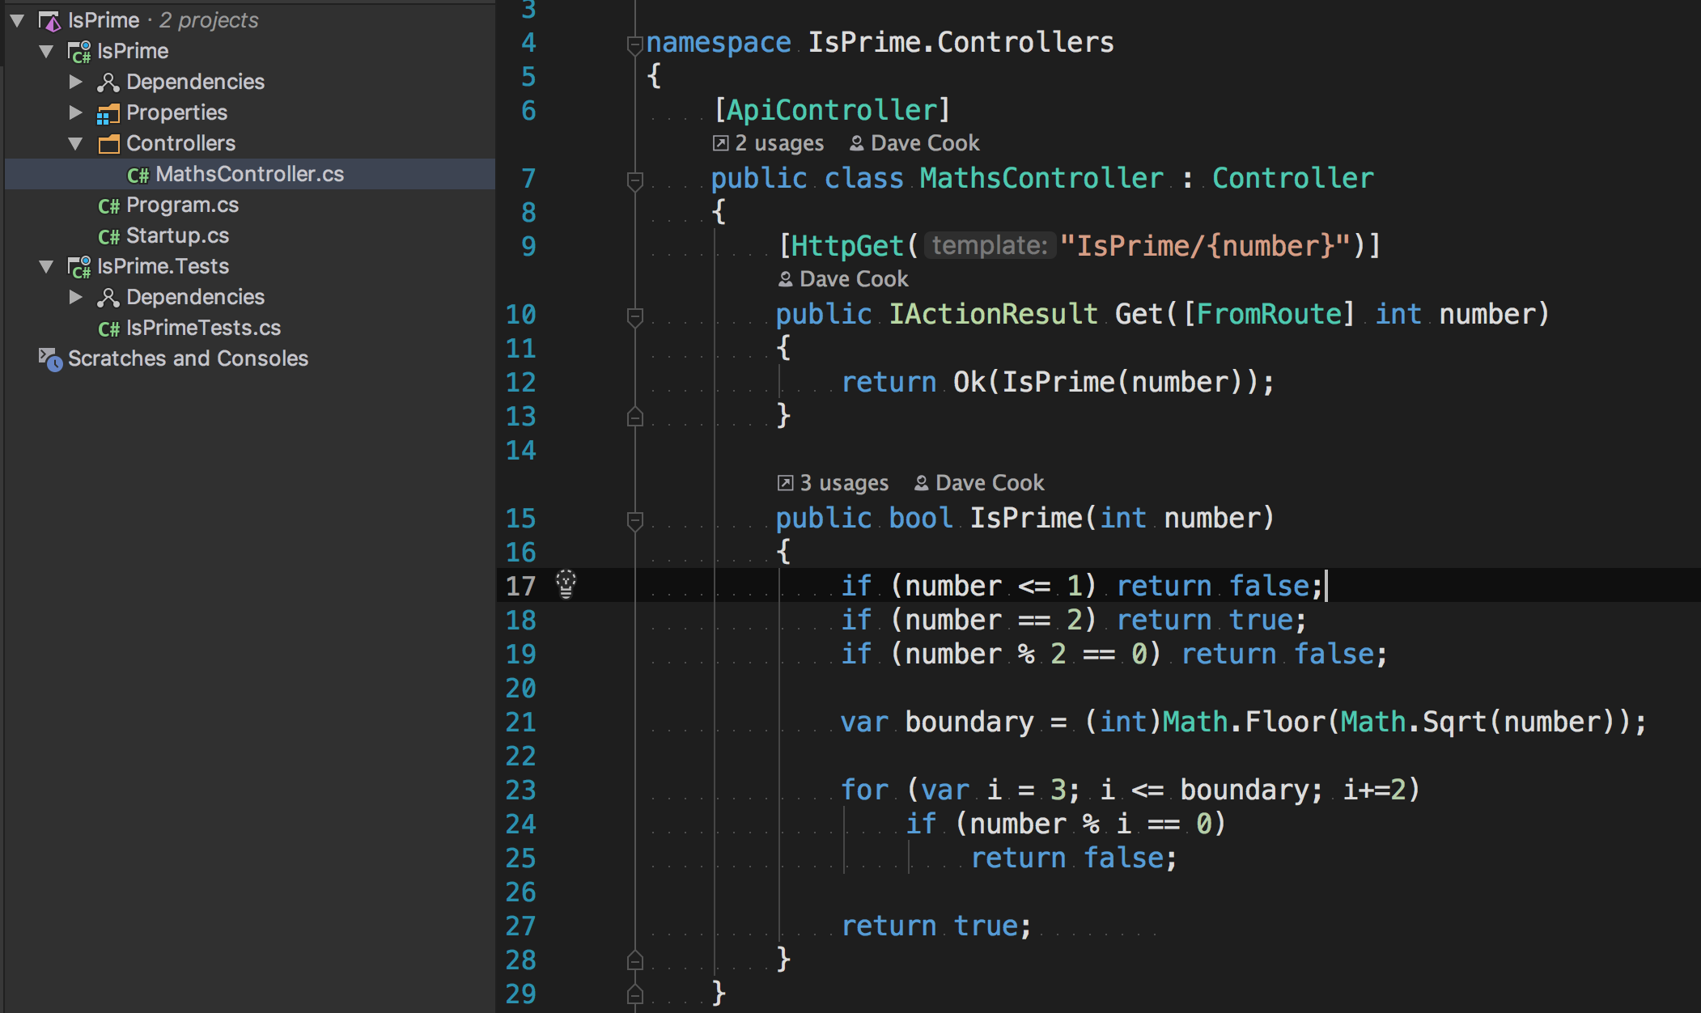
Context: Our Sample service
Notes:
In a moment we will have a look at our first DockerFile
But before that, let me first introduce the application that we are going to be Dockerising: A really simple web api project, running on .Net Core.
This provides a single HTTP endpoint to make a get request, and returns a response indicating if the supplied parameter is a prime number or not.
On the left you can see the solution structure – there is a single project folder called IsPrime which contains the WebApi service, and a single test project called IsPrime.Tests, with a few tests to run over the code on the right.
The code in the service is super simple - I’ve omitted things like error handling and Dependency injection for clarity.
Something you can’t see here is that this service is configured in Program.cs to run on Port 9021

Slide 14
Our Dockerfile

Slide 15
Build an Image
docker build -t isprime_dotnetcore:1 .

Slide 16
Demo – Build an Image
Notes:
docker build -t isprime_dotnetcore:1 .

Slide 17
Start a Container
docker run -p 80:9021 isprime_dotnetcore:1

Slide 18
Demo – Start a Container
Notes:
docker run -p 80:9021 isprime_dotnetcore:1

Slide 19
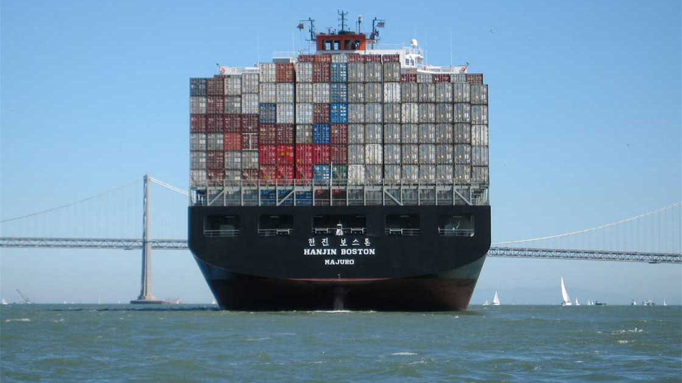
Docker Compose

Slide 20
Docker Compose YML

Slide 21
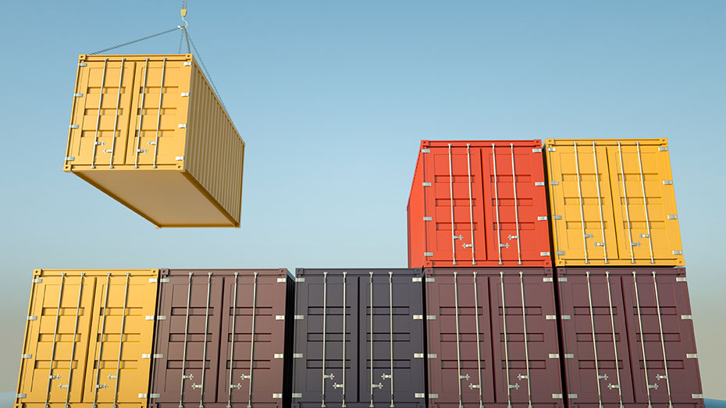
Docker in Production

Slide 22
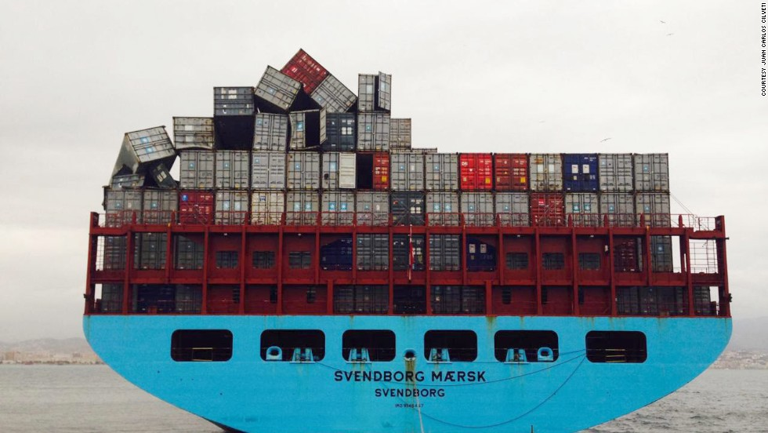
New Challenges

Slide 23



Questions?
https://medium.com/@dcook_net
@dcook_net
https://github.com/dcook-net/
Slides & code : https://bit.ly/2EO2lth

Slide 24
Resources
Exploring Net Core Docker Files - Andrew Lock
Docker for .Net Developers (7 part Series) - Steve Gordon
Announcing the Microsoft Container Registry - Rich Lander
How To Build a Smaller Docker Image – Medium
What's wrong with Latest and The misunderstood latest tag
Play with Docker Classroom - Dockers Labs
https://docs.docker.com/engine/examples/dotnetcore/

Slide 25
Other stuff I couldn’t fit in
Security – which user are you running as?
dockerIgnore files – exclude files from your build context to keep images smaller

Slide 26
What can Docker give me and my team, right now?
Control
Speed
Repeatability
Notes:
Never mind all the sale pitch, and dev ops bla bla.
What problems does it solve for a team of people trying to deliver software, regardless of whether they have permission to use Docker in production?
Works on my machine
New team members up and running quick – no more installation and setup guides that takes days: just pull the repo and run!
Less technical team members up and running quick, with no detailed knowledge how the software all hangs together
Infrastructure as code
Maintainable, reproducible build and test process
Means that context switching between applications is much less painful
Language agnostic
Tech agnostic
OS agnostic
Fast
Need to explain all this!

Slide 27
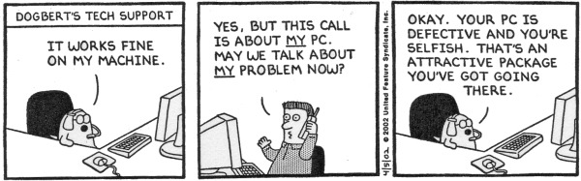
Why use Docker?
Fast, and reduces manual setup tasks, making the team go faster
Sort after skills, can be applied to any OS or programming language
“Works in my Container!” == “Well I guess it just flippin’ well works then!”
Notes:
It’s fast, in many aspects:
spinning up a container can take as little as a few seconds, especially Unix containers which are mush faster than Windows containers
new devs on the team can be setup in minutes instead of hours, days or weeks, so they can start delivering value faster
Massively reduces the burden of keeping software running on less technical team members development environments
Enables automation, and therefore reduces human error and speeds up delivery.
Its also a highly sort after skillset – industry standard – stack overflow (Expand a little)
OS & Language agnostic – so it fits well with polyglot development
Everything just works ‘out the box’ solves the age old headache of environment setup and configuration of new environments and workstations, so gone are the days of ”Works on my machine!”
And, as already stated, puts you in control of infrastructure – you’ll see exactly how and why that is soon.

Slide 28
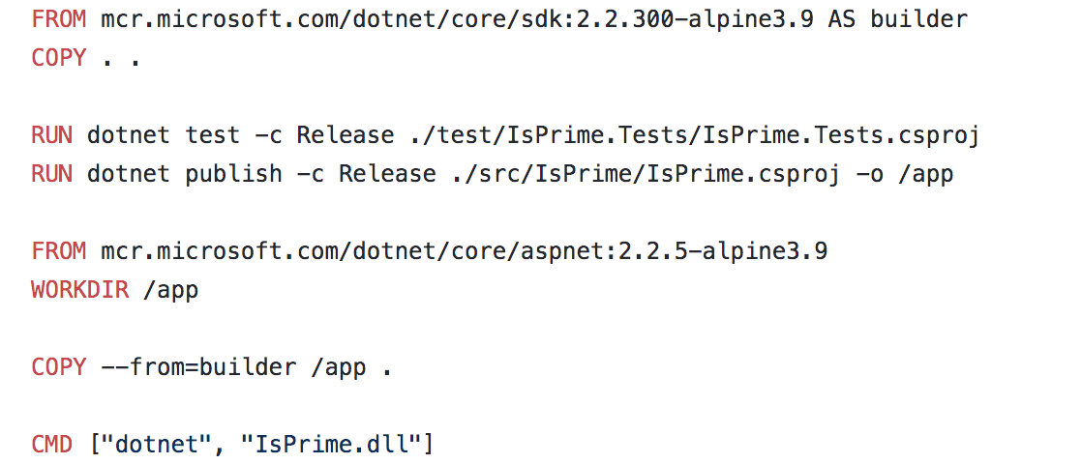
Dockerfile – Layer our App on top of .Net

Slide 29
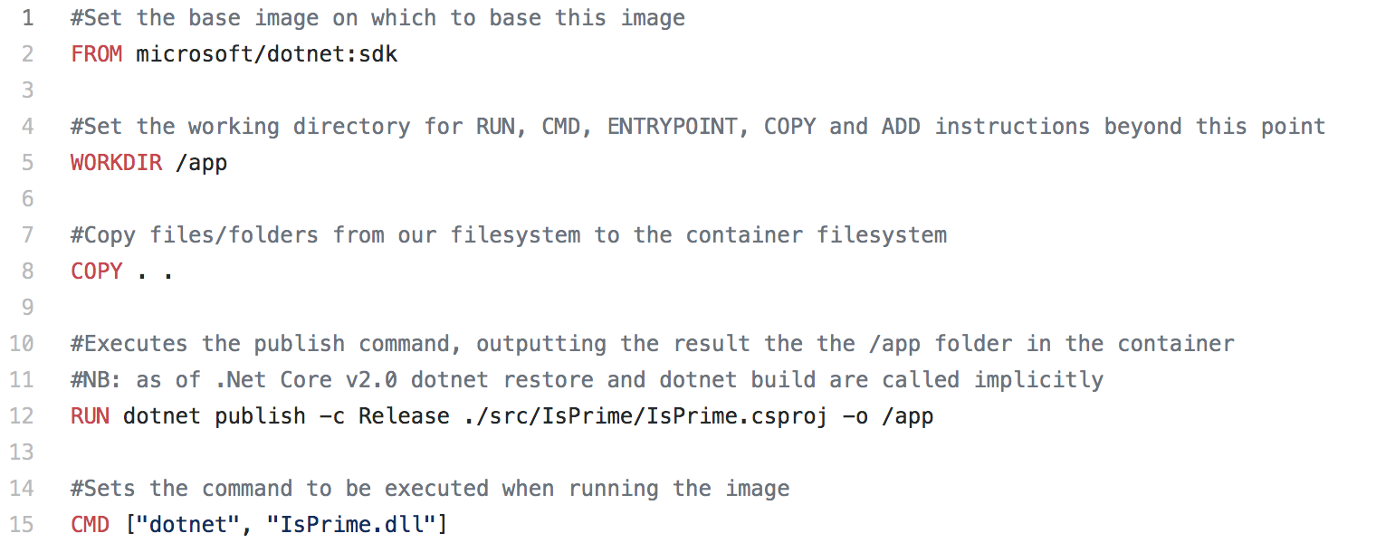
Dockerfile_v1 - Issues
Notes:
What’s wrong with this then?
A number of things!
It doesn’t run any of the tests from the solution, so we could be generating an image to load up a service that compiles ok, but actually doesn’t behave quite how we expect it to.
Our image is based on the .Net Core SDK, rather than the runtime. We don’t want to use the SDK in production: the SDK is much bigger than the runtime, so takes longer to download, and obviously has a much larger attack vector and opportunities for misuse. Just like how we’d never install the full SDK of the .Net Framework on a production server, we don’t want to use it in Docker either.
The copy instruction copies WAY too many files to the the Container – it’s copied literally everything from the root of our project to the image, so again, increasing the size of the image, and therefore the time to download it.
It’s not deterministic – because we have not explicitly specified a version tag, Docker is defaulting to a tag called Latest. There are many ways in which this can come back to haunt us, because Latest doesn’t necessarily mean latest as you would expect, and as a result this can result in building your image on a complexly different version to what you actually wanted, which means that you can run the same command twice and end up with different results.
So lets improve upon our first attempt a little, starting with repeatable builds.

Slide 30
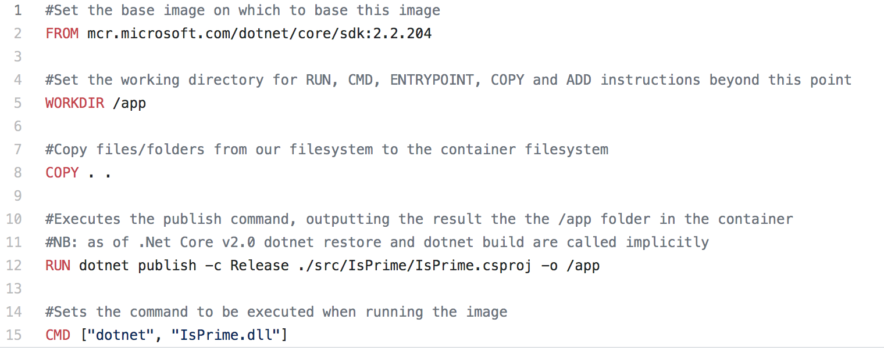
Dockerfile_v2 - Deterministic
Notes:
In this version of our Dockerfile we’ve updated our FROM instruction to use a version Tag to specify a fully qualified semantic version number – in this example, v2.2.204.
This means that whenever and where ever we build an image from, we’ll always be using 2.2.204.
The same Docker image will be generated whenever we rebuild it, which means my continerised Service will behave the same, because my build artefacts haven’t mysteriously changed between builds.
Yeh!
Now the observant amongst you may have noticed that this from statement contains more differences than just a version number.
It still requests the .Net Core SDK, and it’s still a Linix image (although again, that isn’t obvious).
But this time it’s prefixed with mcr.microsoft.com…
This is because I am now pulling my base image not from DockerHub as in the previous example, but from Microsoft’s own container registry (MCR for short).
MS no longer host patch versions of their images on Dockerhub, only on MCR, so if you want to be this specific about your image versions as this, then you need to get your images from there instead.
In fact, it’s probably best to pull your images from the MCR even if you are not being specific about versions numbers, because Dockerhub redirects to MCR anyway, so it should be a little quicker.
I’ve include a link explaining the reasons behind this on the resources slide at the end.

Slide 31
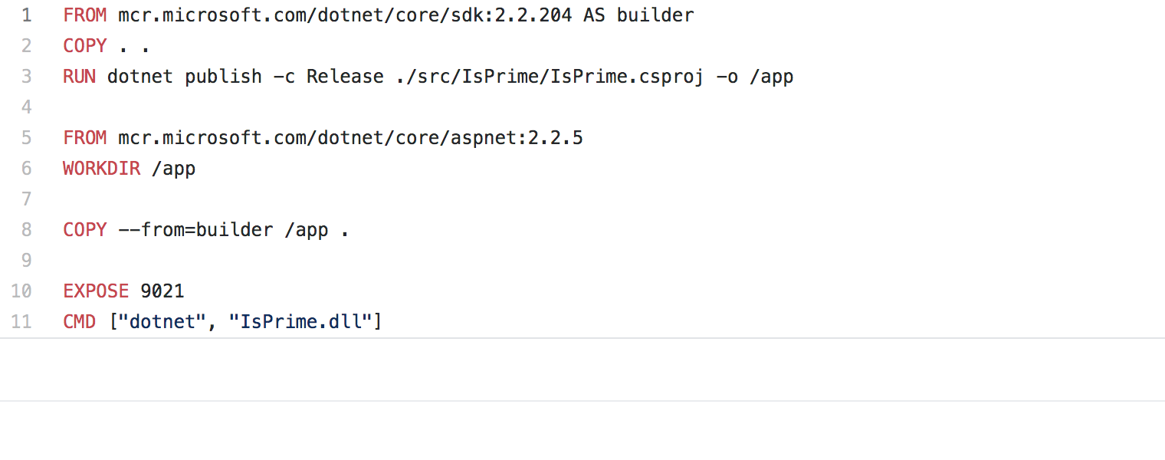
Dockerfile_v3 – Multi Stage Dockerfile
Notes:
In this version of our Dockerfile, we address the issue of using the SDK in our production environment by using a Multistage Dockerfile.
A Multistage DockerFile contains multiple FROM instructions, with each FROM instruction creating a new stage.
You can selectively copy artifacts from one stage to another, leaving behind everything you don’t want in the final image.
This example contains 2 stages.
The first stage executes a FROM instruction using the SDK that we used previously to create an image,
The second stage, which starts on line 5 with the second FROM instruction, specifies the base image to create a new image based on the .Net Core ASP Net runtime (Note that we are using a Tag to request a
Specific version of the runtime image in order to get deterministic builds)
Then on line 8 we copy the contents of the app folder from the first stage to the final image that we will use as our build artefact.
It does this using the Name we gave to the first stage at the end of line 1.
Everything works exactly the same as it did before, but this time, our final image that we will create Containers from is built on top of the smaller, less vulnerable Runtime image.
Do another quick demo to show that everything still works.

Slide 32
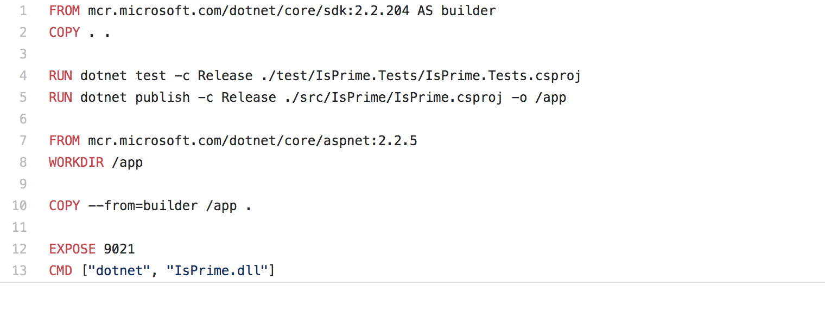
Dockerfile_v4 – run the Tests
Notes:
In this version of our DockerFile we want to ensure that we only generate build artefacts if our service is actually behaving the way we expect, ie it meets the specification
In order to do this, we need to run the tests from with our Test Project.
In order to run our tests we need to use the SDK to run the dotnet test command (an operation we cant run using the runtime).
On line 4 we now execute Dotnet test against the test project that has already been copied to our builder stage.
At this point, if any of the tests in that test project fail for any reason, the rest of the build will stop and exit with an error code. (Check this is all correct)
Again – quick demo to show everything still works (Failure Demo??)

Slide 33
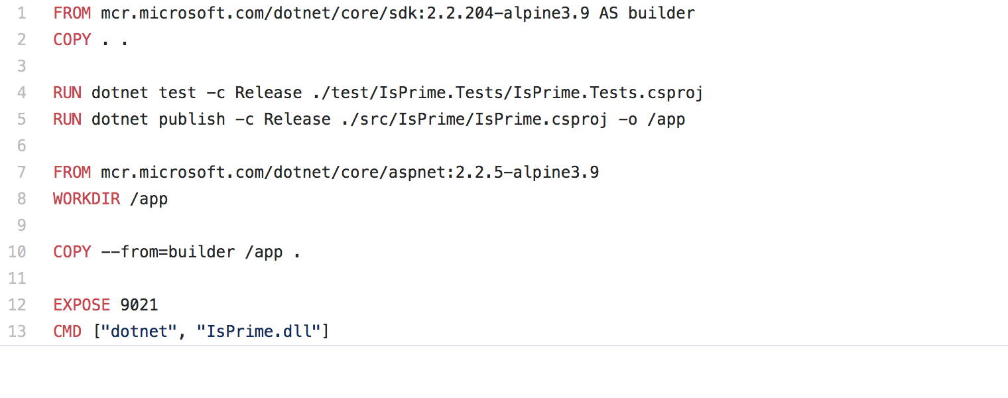
Dockerfile_v5 – smaller images FTW!
Notes:
In our final revision of our Dockerfile, we have made a very minor adjustment to the base images that well use in our Multistage build process.
At the end of lines 1 and 7 you will see that the image Tags now include an Alpine version.
This change is aimed at reducing the size of our images so that they build faster, and so that we can push and pull them from our container registry faster.
This is because Alpine is a very light weight version of the Unix operating system. Other choices include Debian & Ubuntu.
Lets have another quick demo to check things still work, and have a look at how much we’ve brought down the image size with all these improvements.

